Slide 1
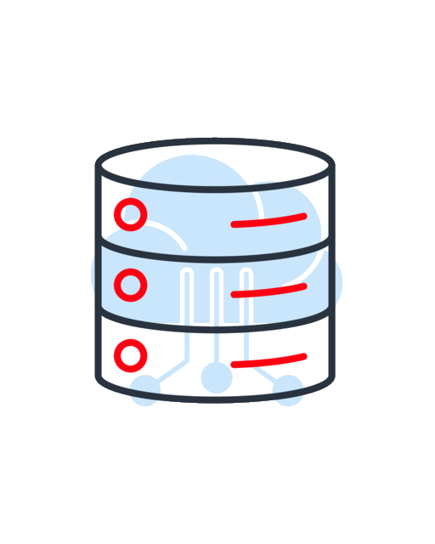
University Student Project Repository
Angelica RINGS, Robert-Alexandru KISS, Enzo VERDIER--TURRIN, Louis COLBUS, Sven BARNICH

Slide 2
Table of contents
01
02
03
04
05
06
Motivation
Users
Functional Requirements
Non-Functional Requirements
07
08
Use Cases
System Architecture
Live Demo
Retrospective

Slide 3
Why make a student project repository?
The Problem:
Our proposed Solution:
Lost files
Fragmented storage
  Projects scattered across Moodle
  Local hard drives
  Descriptions in loose emails
Inaccessible to all students
Centralized DB
Showcased projects
Searchable by tags
Accessible to all students and supervised by administrators

Slide 4
Users
Students | Professors and Recruiters | Administrator
Upload and manage their project | Browse projects | Approve new uploads
Manage profile | Rate projects | Remove inappropriate or outdated content
Rate other projects
View portfolio

Slide 5
Functional Requirements
Software Engineering 1
Users/Students | Professors/Recruiters | Website Administrators
Log in | Log in | Log into Admin account
Upload Project Files | Browse Projects (with filter) | Approve new uploaded Projects
Edit / Delete uploaded Projects | View Student Profiles & Project Details | Remove inappropriate or outdated Projects
Manage Student Profile |  | View Student Profiles & Project Details
Manage Project Collaborators
View other students’ Profiles & Project Details
Rate other students’ Projects
View average star rating per Project

Slide 6
Non-Functional Requirements
Software Engineering 1
Performance | Performance | Storage
Fully functional on screens from 360px to 1920px width | Support at least 200 concurrent users without performance degradation | Must support files up to 500 MB
Response time of < 3 seconds | 99.5% uptime during Uni business hours | Store Project Data in a structured DB
 | Modular architecture for simplicity
Accessibility |  | Security
Adhere to the Web Content Accessibility Guidelines |  | Hash and salt all passwords before saving

Slide 7
Requirements: Not Met
Software Engineering 1
Users/Students | Professors/Recruiters | Website Administrators
Log in using university email | Log in using email | Access content modification logs
Security | Storage | Accessibility
Maintain history of all content modifications and admin actions | Monthly backups retained for 60 Days | Adhere to the Web Content Accessibility Guidelines
Secure HTTPS access
Scan for potentially malicious files

Slide 8
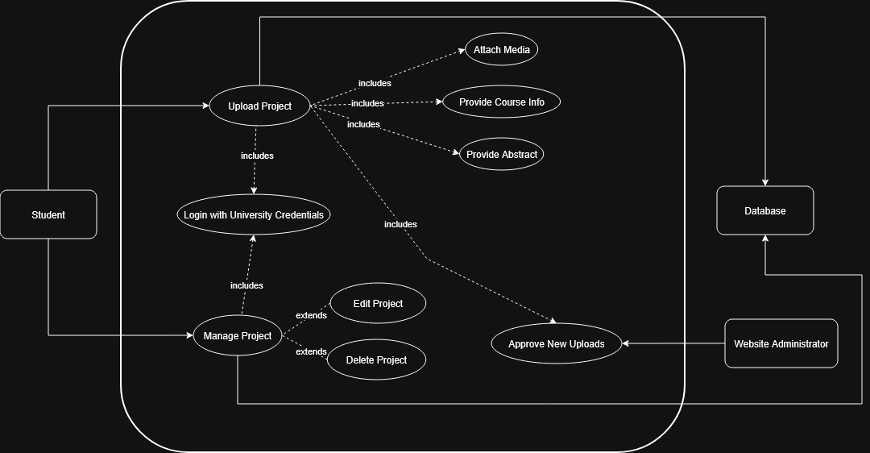
Use Case
Upload Project Use Case
Core User actors: Student, Administrator
Core User flow:
Upload Project(s) including Media, Course Info, Abstract
Manage Project(s)
Crucial Dependency:
Administrator needs to approve Project before it’s publicly displayed

Slide 9
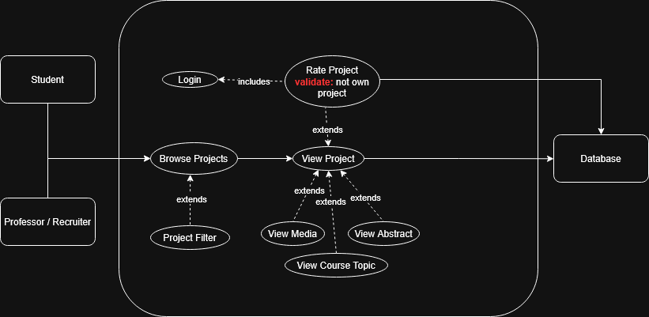
Use Case
Project Rating Use Case
Core User Actors: Student, Professor/Recruiter
Core User flow:
Browse approved projects
View project details
Rate a project with a star-based rating
Crucial Dependency:
User must be logged in to submit a rating
User can’t rate its own project

Slide 10
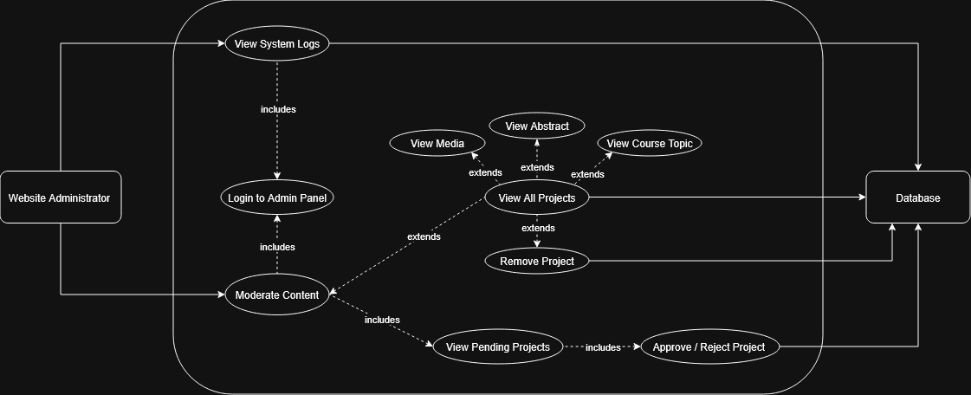
Use Case
Content Moderation Use Case
Core User Actor: Administrator
Core Admin flow:
View System Logs
Moderate Content
  View pending Project(s) and decide approval
  View existing Project(s) and delete if necessary
Crucial Dependency:
Administrators needs to log in before being able to moderate

Slide 11

System Architecture
REACT Client
Rest API / Flask
SQLite DB
File Storage
3-Tier Modular Architecture
Frontend:
Built with React, TypeScript, Vite & Tailwind CSS
No page reloads, fast data fetching
Backend:
Uses Python with Flask, bcrypt, PyJWT
RESTful endpoints, handles logic, authentication, permission checks
Database:
Utilizes SQLite
Lightweight

Slide 12
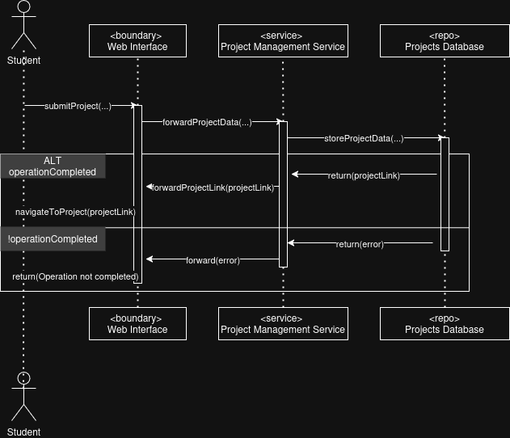
Sequence diagram
How data is processed by the system during an Upload:
The Boundary (React): collects file and metadata
The Service (Flask): validates token and file size
The Repo (DB): stores the metadata, while file is written to disk
The system returns a success message, flags projects internally as “approved=False”
In case of error → returns error instead

Slide 13
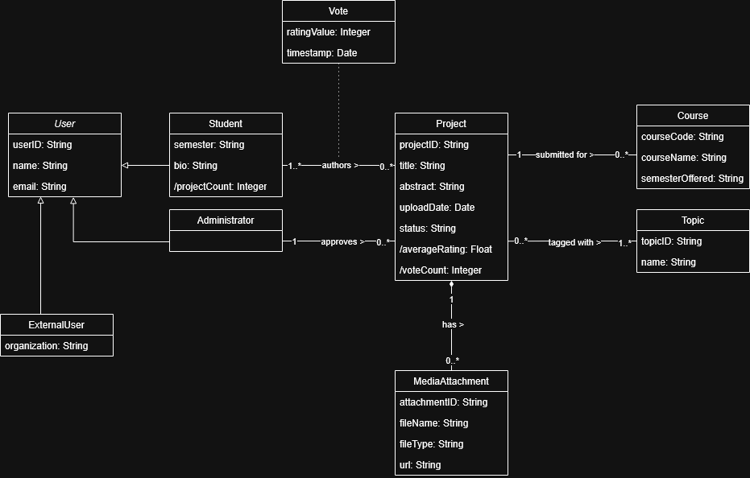
Class diagram
The “brain” of our Repository
User is a superclass for Student and Admin
Created a relationship that allows for multiple authors per project
Projects are tagged with Topics. Also N-to-N relationship, allowing for flexible categorization

Slide 14
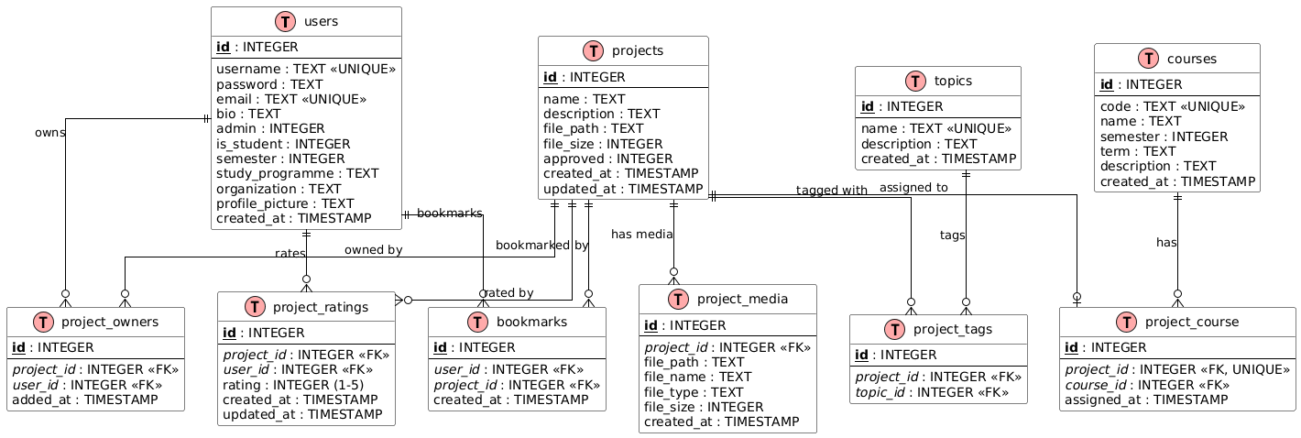
Database
Normalize the DB to 3NF to avoid data redundancy
We store the path to files in the DB, and the actual file on the server to avoid performance degradation
We use JSON Web Tokens for authentication, this enables the backend to be “stateless” – no data stores in server memory

Slide 15
From idea to project: be publicly available
Oracle Cloud
Virtual Cloud Network
Ampere A1 VPS (Arm processor):
  4 OCPUs
  24 GB of RAM
  200 GB block volume (storage)
  Ubuntu 25.10
No HTTPS for now
Subdomain se1.insects.ltd mapped to public IP 130.61.214.41 using CNAME record
Ingress rule to allow traffic on TCP port 3000 (for Vite server)

Slide 16
Conclusion & retrospective
Overall, the MVP has been properly implemented… but,
the project is not done yet:
Still requires clean up, refactor, finding bugs and fixing them
Switch to production WSGI server, add HTTPS
Start rotating JWT secret key, think about vectors of attack like XSS and SQL injection

Slide 17
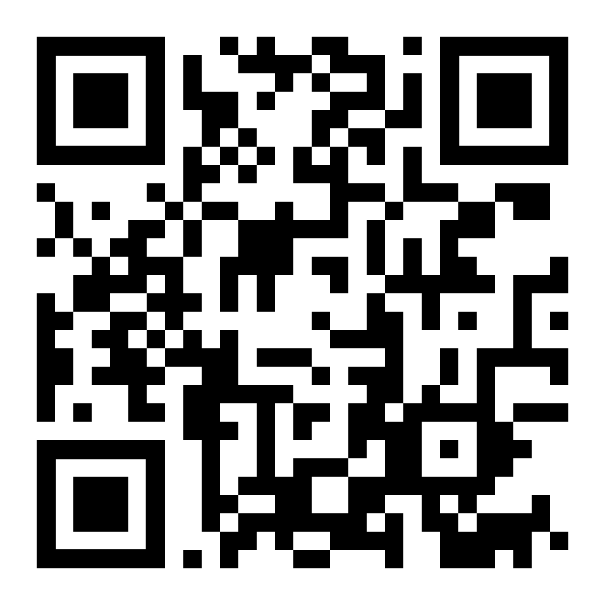
LIVE DEMO
You can try for yourselves!
http://se1.insects.ltd:3000/

Slide 18
Contribution: Implementation
Feature | who implemented | what contributed
Frontend setup & core UI | Angelica | Front end setup general UI structure, layout styling, light mode
Explore page | Angelica | Explore (main) page, project listing filtering, project cards
Project pages | Angelica | View project page, upload project page, edit project functionality
User profiles | Angelica | Profile page, visibility, pending projects view, upload profile picture
Admin features | Angelica | Admin logs, pending project review, user management, notifications, topic and course management

Slide 19
Contribution: Implementation
Feature | who implemented | what contributed
Notifications | Angelica | Notification (edit, delete, approval, ratings) tab and page
Bookmarks | Angelica | Bookmarking projects
Reporting system | Angelica | Report user and report projects
Authentication | Angelica | Login/sign up UI, account info handling
Unit tests | Angelica | Backend unit tests (DB and API endpoints)
Backups | Angelica | Script for the automated backups
Rating system | Angelica | Rating UI

Slide 20
Contribution: Implementation
Feature | who implemented | what contributed
Authentication | Robert | Login/ sign up logic
Admin moderation | Robert | Admin approval of projects topic
Upload Projects | Robert | Edit projects and edit profile UI
Backend database & API | Robert | CRUD database, API endpoints, database integration
UI styling tweaks | Robert | Colour changes and minor UI tweaks

Slide 21
Contribution: Implementation
Feature | who implemented | what contributed
User Profiles | Louis | Public user profiles
Misc fixes & config | Louis | File extension fixes, API, URL fixes
CI / DevOps | Louis | Backend CI workflow test automation
Hosting | Louis | Deploying and hosting application

